Slide 1
News Category Dataset
Analysis
Prueba técnica W & J
David Ricardo Vivas Ordóñez
2020

Slide 2
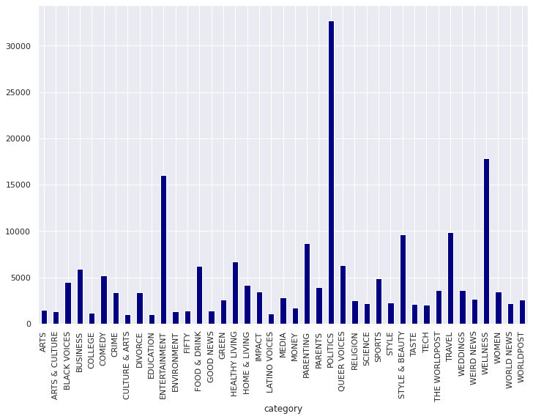
Initial exploration
Dataset contains news from the Huffington Post (US online newspaper)
Each entry contains authors, date, headlines, link and short description
200853 articles
41 unique categories
Some seem duplicate or highly correlated (Worldpost, The Worldspost)
Highly imbalanced: politics makes the vast majority of articles, followed by entertainment and wellness

Slide 3
can we classify it in one particular category?
Yes!
By using machine
learning
Given an article’s headline and a short description...

Slide 4
Transformer news classifier
Category
Model is trained to automatically classify news
Transformer was already trained on a huge amount of data
Transformer decomposes each sentence in an abstract, high-dimensional representation
Part of this output is fed to a classification neural-network (perceptron)
The final output of the model is the category chosen by the model
Perceptron
Transformer
Model | Accuracy (on new data)
BERT | 72%
distilGPT-2 | 70%
Encoded sentence

Slide 5
can we find representative words of such category?
Yes!
By using statistics
Given some articles of the same category...

Slide 6
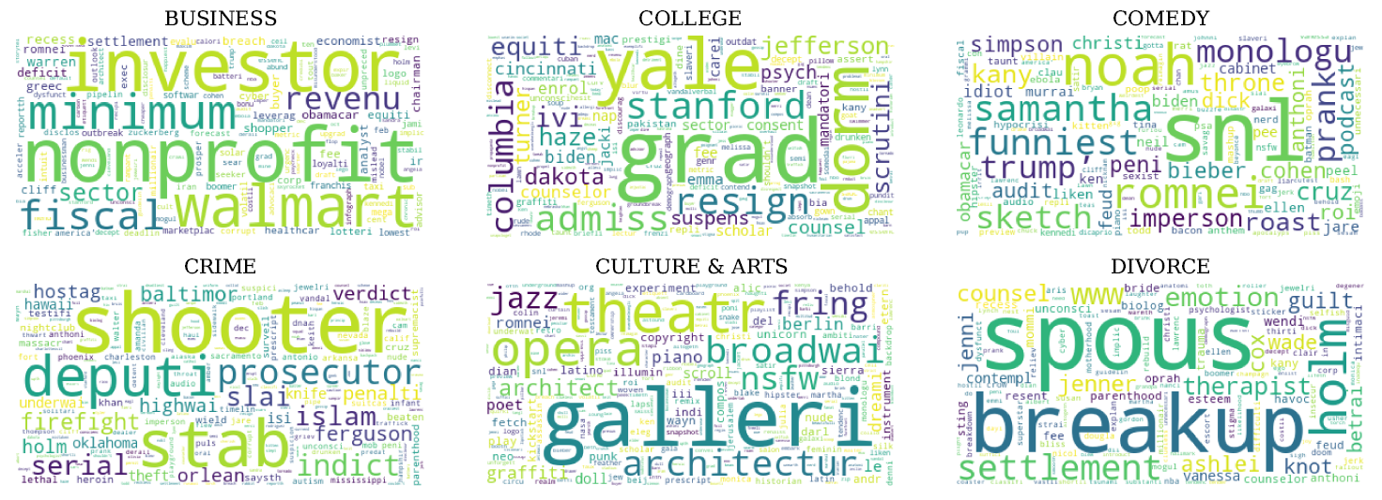
2. TF-IDF relevant word retrieval
TF-IDF stands for term frequency–inverse document frequency
This methods uses the frequency of words in a document and along different documents to determine their relevance in an unsupervised way
We can see for ourselves that the retrieved words are highly related to its categories
Some words are characteristic of the dataset’s time frame (ebola in healthy living & impact, 2014-2016 outbreak)

Slide 7
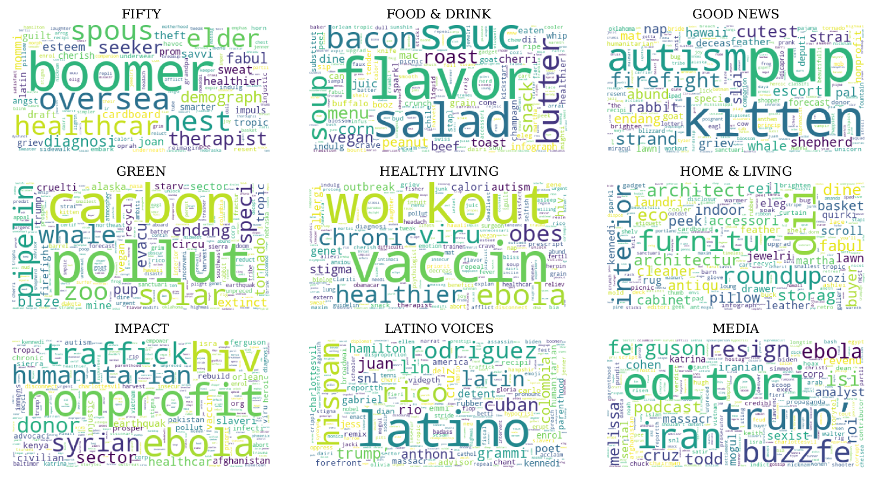

Slide 8
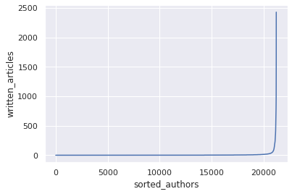
3. What information can be retrieved regarding the authors?
20.000-22.000 unique authors
~7 average articles per author, with high dispersion
This makes sense after plotting the sorted frequency distribution for individual authors, which evidentiates that most of the papers are written by a small fractions of authors
The top 100 authors (regarding amount of articles) have a scope of 9 distinct categories on average
The highest amount of articles wrote by a single author was 2428
The author with the widest category scope wrote in 38 different categories

Slide 9
can we find topics in an unsupervised way?
Yes!
By using machine learning, again
Given a bunch of article headlines and a short descriptions...

Slide 10
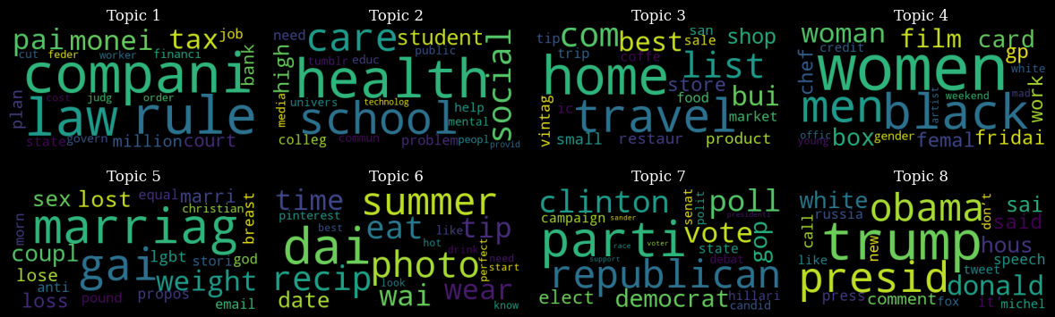
4. LDA topic modelling
!
LDA stands for Latent Dirichlet allocation
Unsupervised learning technique
Creates abstract groups that can relate observations to each other
Allows to model topics from a text dataset
We can associate topic 1 to finance, topic 2 to student health, topic 6 to leisure, topics 7 and 8 to 2016 USA elections, etc.

Slide 11
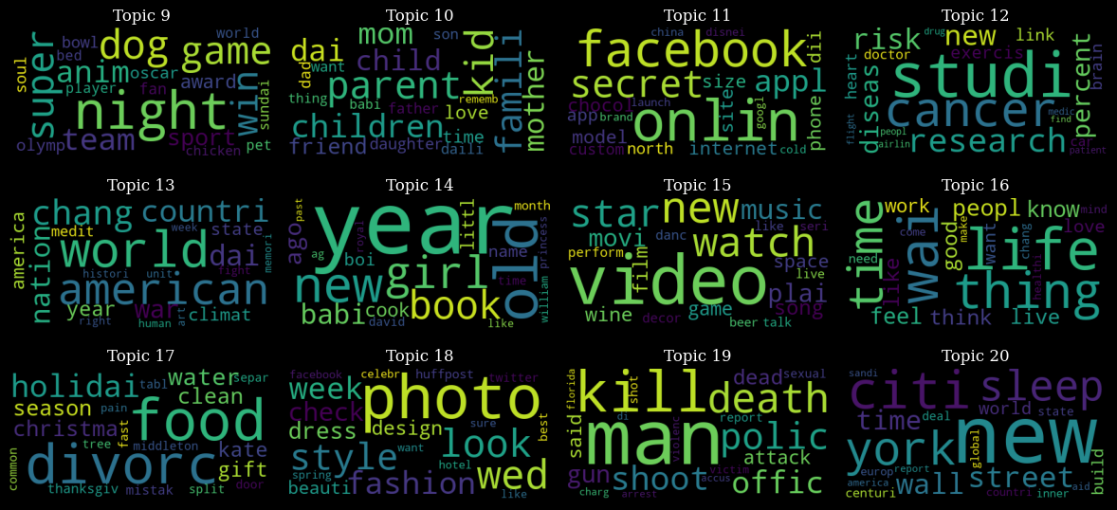

Slide 12
can we categorize them as positive or negative?
Yes!
By means of sentiment analysis
Given a bunch of short descriptions...

Slide 13
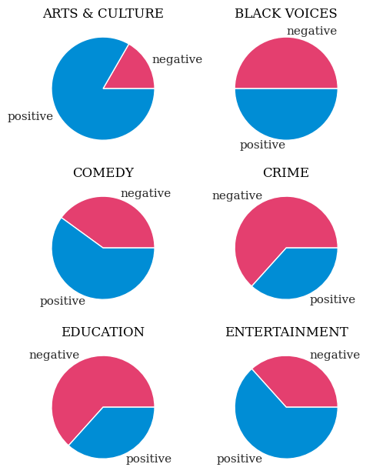
5. Sentiment analysis
Transformers can also be used for sentiment analysis
Binary sentiment analysis can be performed in a few lines of code using Huggingface Transformers library
Some results behave according to expected, with crime category having mostly negative entries and culture mostly positive, amongst other examples
For computing cost reasons, only a limited amount of samples were selected per category

Slide 14
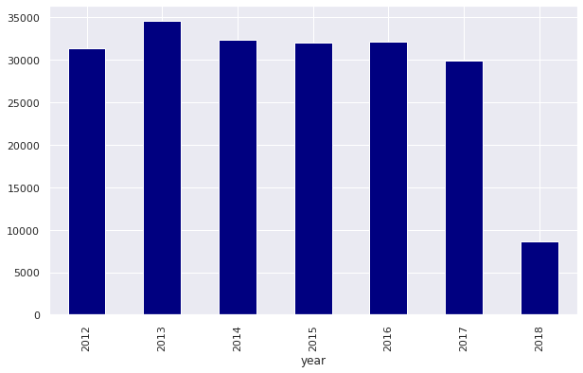
6. What information can be retrieved regarding the years?
Time frame January 2012 - May 2018
Quasi-uniform amount of news articles per year 2012-2017
We can use TF-IDF to find relevant words per year
Highest relevance topics tend to be negative, such as the ones related to the ebola outbreak and Charlie Hebdo massacre

Slide 15
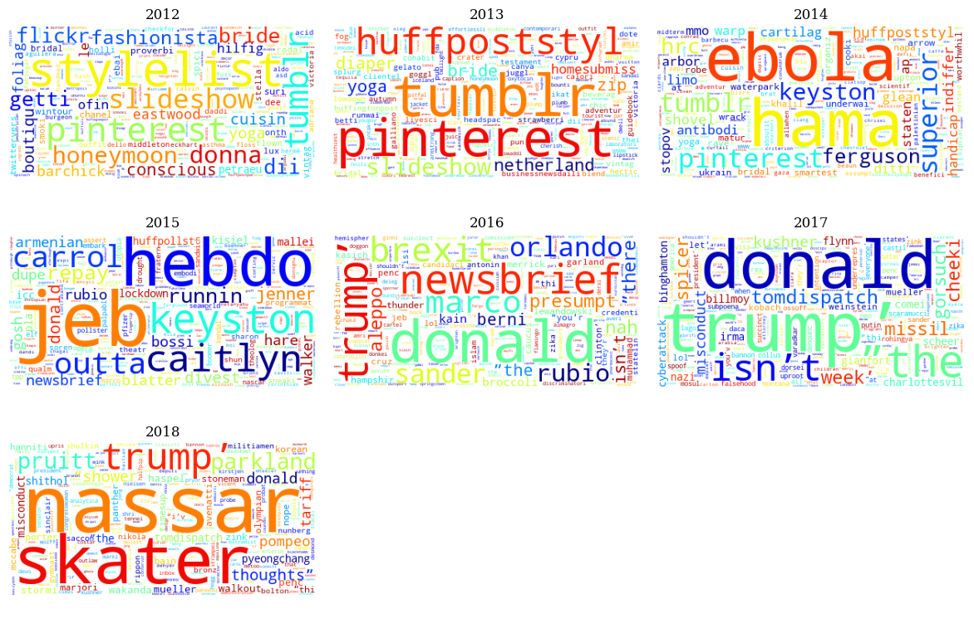
!
Well well… while 2012 and 2013 can be considered as relatively peaceful years (at least in occident), 2014 is characterized by the ebola outbreak, 2015 by the Charlie Hebdo massacre, 2016 by topics such as presidential elections, brexit and the Orlando shooting, 2017 by Trump’s government and early 2018 by the Larry Nassar scandal. Predominance of political topics can be attributed to the high inbalance of the dataset

Slide 16
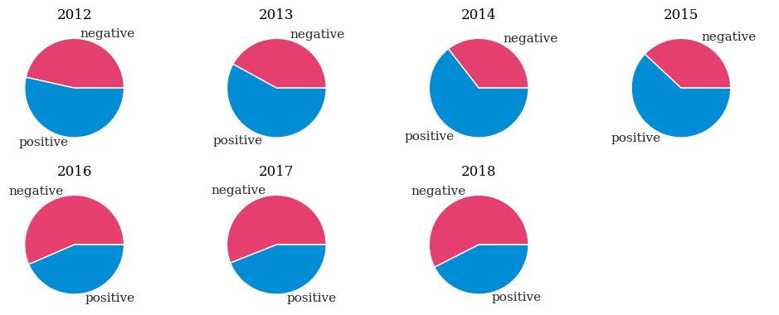
Was it a good or a bad year?
Results of performing binary sentiment analysis on data from each individual year, 200 samples per year.

Slide 17




Libraries used

Slide 18

Thank you!

